Slide 1



FP20_Sport Product Sales Analysis_Santanu
View in Power BI
Last data refresh:
7/15/2023 11:34:46 AM UTC
Downloaded at:
7/15/2023 11:56:29 AM UTC

Slide 2
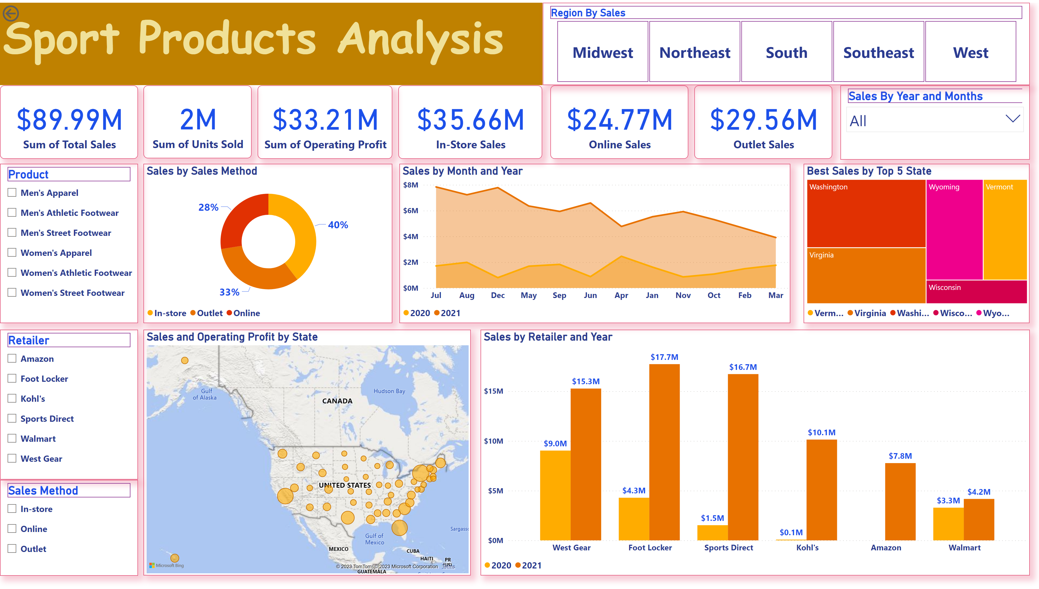
Page 1
Notes:
card
No alt text provided
card
No alt text provided
card
No alt text provided
textbox
No alt text provided
actionButton
No alt text provided
In-Store
No alt text provided
card
No alt text provided
card
No alt text provided
slicer
No alt text provided
slicer
No alt text provided
Sales by Sales Method
No alt text provided
slicer
No alt text provided
Sales by Retailer and Year
No alt text provided
Sales by Month and Year
No alt text provided
slicer
No alt text provided
Sales and Operating Profit by State
No alt text provided
Best Sales by Top 5 State
No alt text provided
slicer
No alt text provided

Slide 3
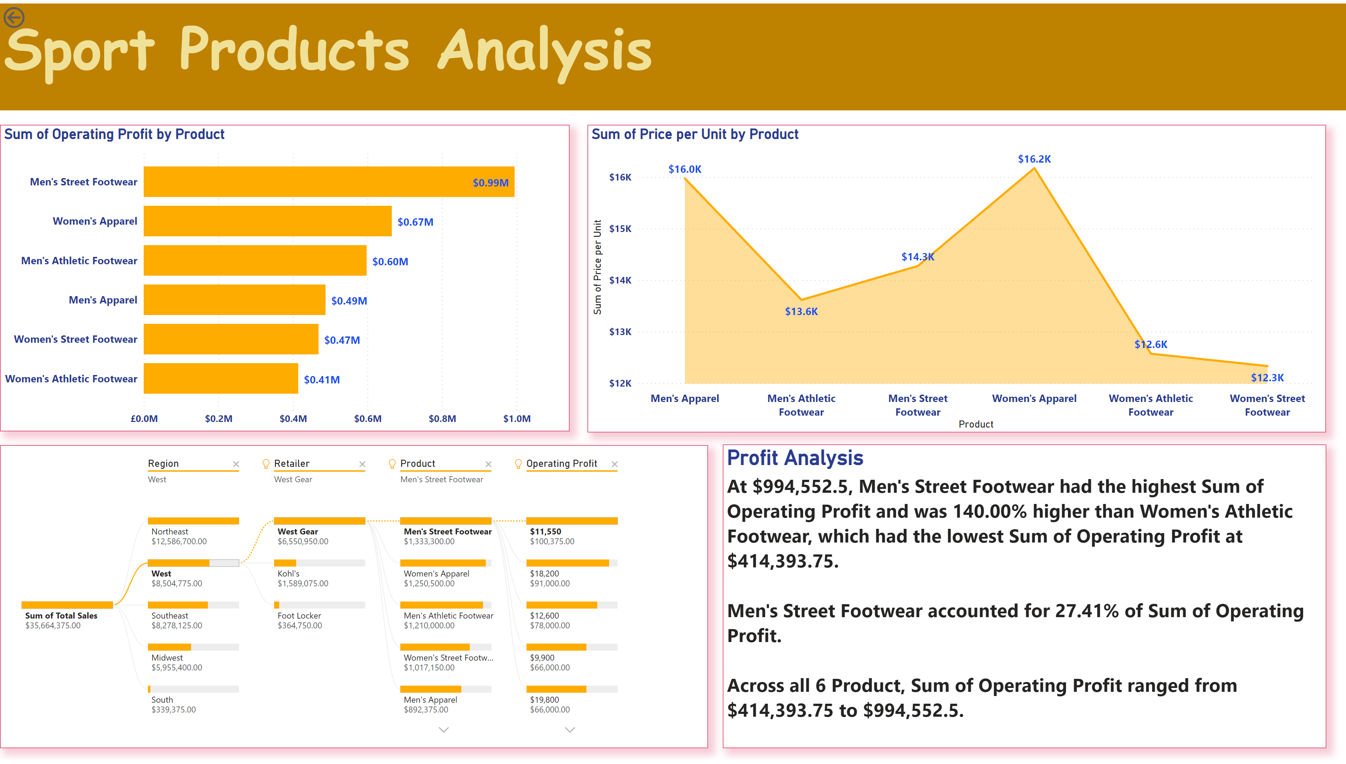
Duplicate of Page 1
Notes:
textbox
No alt text provided
actionButton
No alt text provided
clusteredBarChart
No alt text provided
areaChart
No alt text provided
decompositionTreeVisual
No alt text provided
Profit Analysis
No alt text provided

